Slide 1
Elevator
Maximilian Bauernfeind Simon Stellnberger David Goldberger

Slide 2
Agenda
Architecture
Live Demonstration / Get Into Code
Quality Checks
Lessons Learned

Slide 3
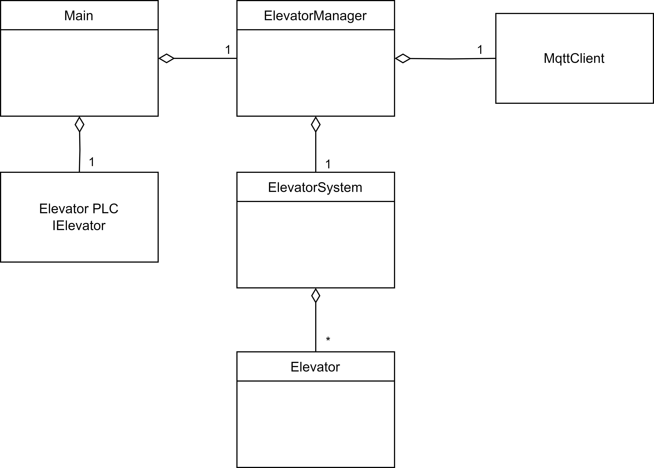
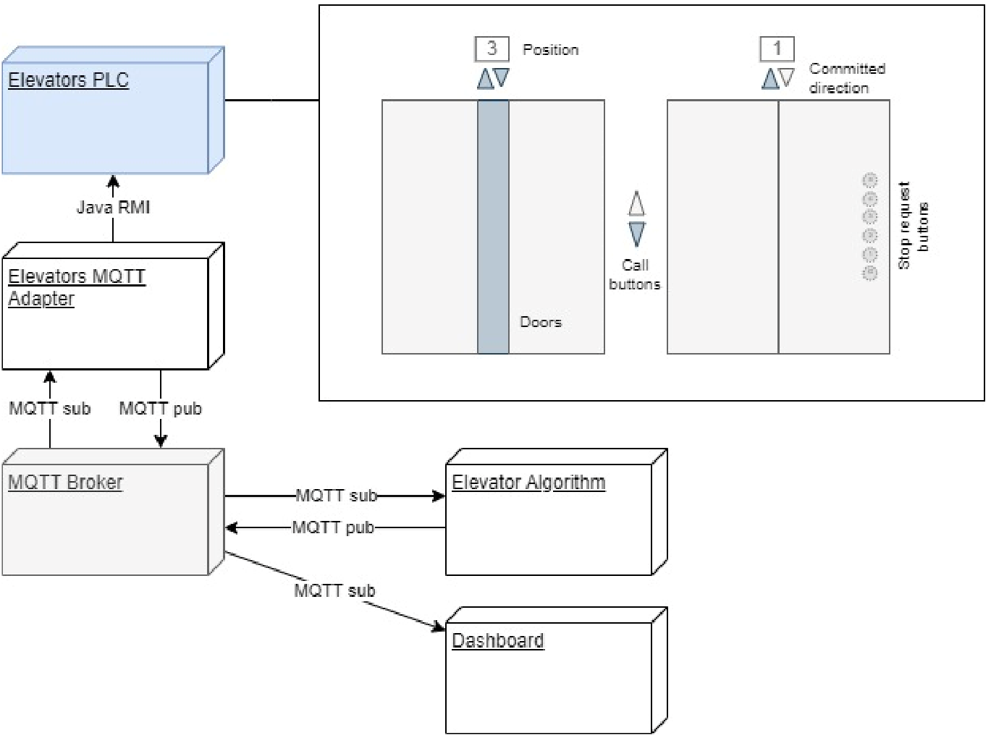
Architecture
Adapter

Slide 4
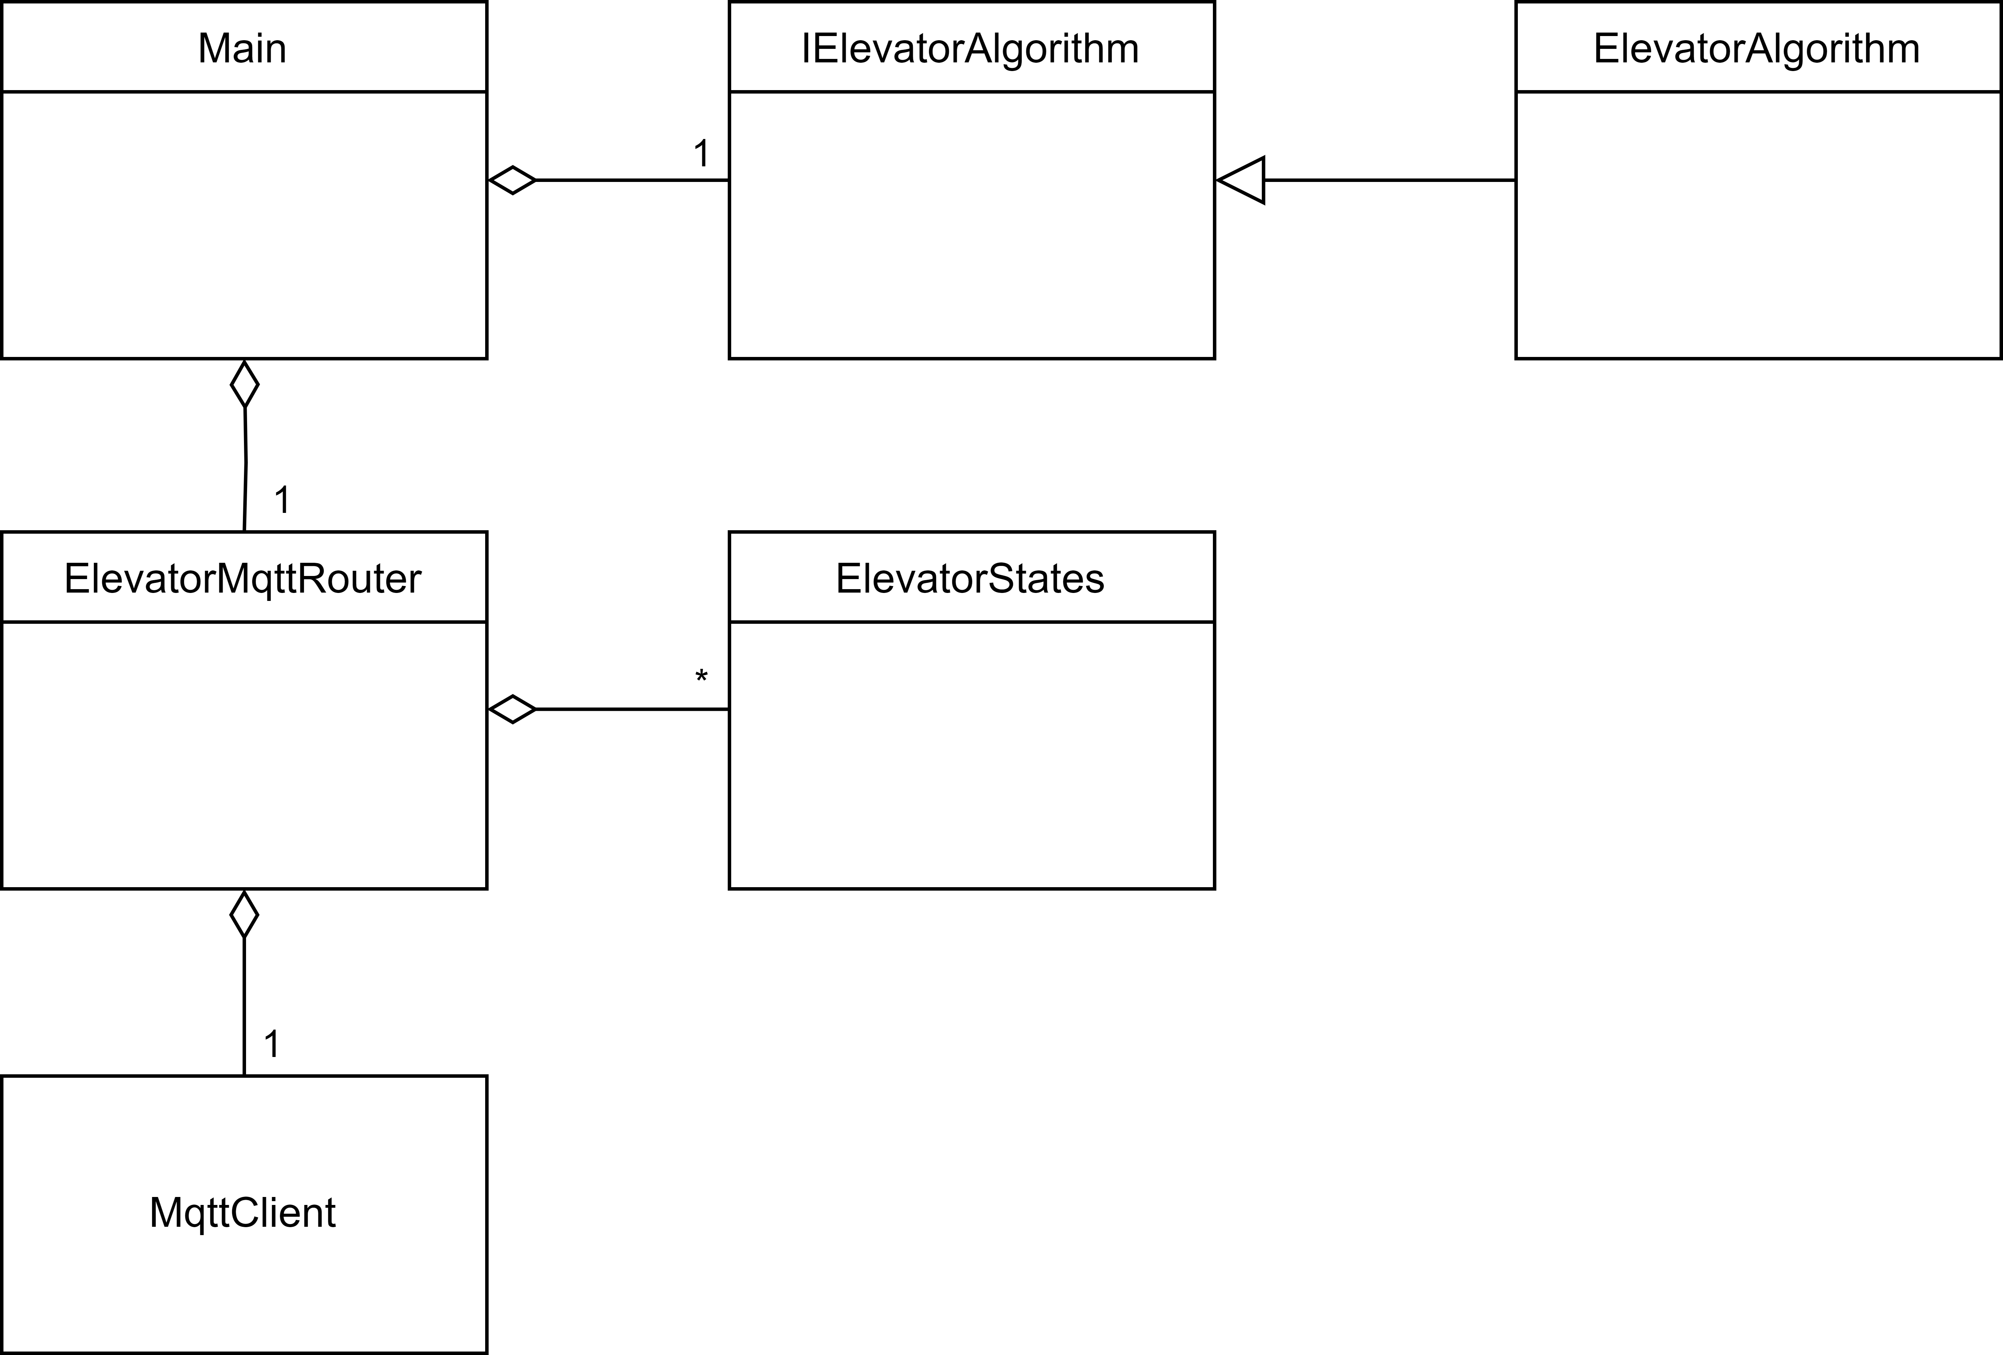
Architecture
Algorithm

Slide 5
Live Demo

Slide 6
Quality Checks
Git Workflow
Branches
- main: the main branch, where only functional code is contained.
- feature/name: for new features. Contains the name of the owner and the topic
- test/name: for tests
- fix[/name]: for bug fixes.
Commit Messages:
- relay on the rules from conventionalcommits.org
- <type>[optional scope]: <description>
Pull Requests
- no direct commit/push on master
- pull requests for all branches
- Pair programming: no reviews necessary

Slide 7
Quality Checks
Test concept
Different Test kinds
- unit tests
- integration tests
- model based tests (automatic) - manual functional system test

Slide 8
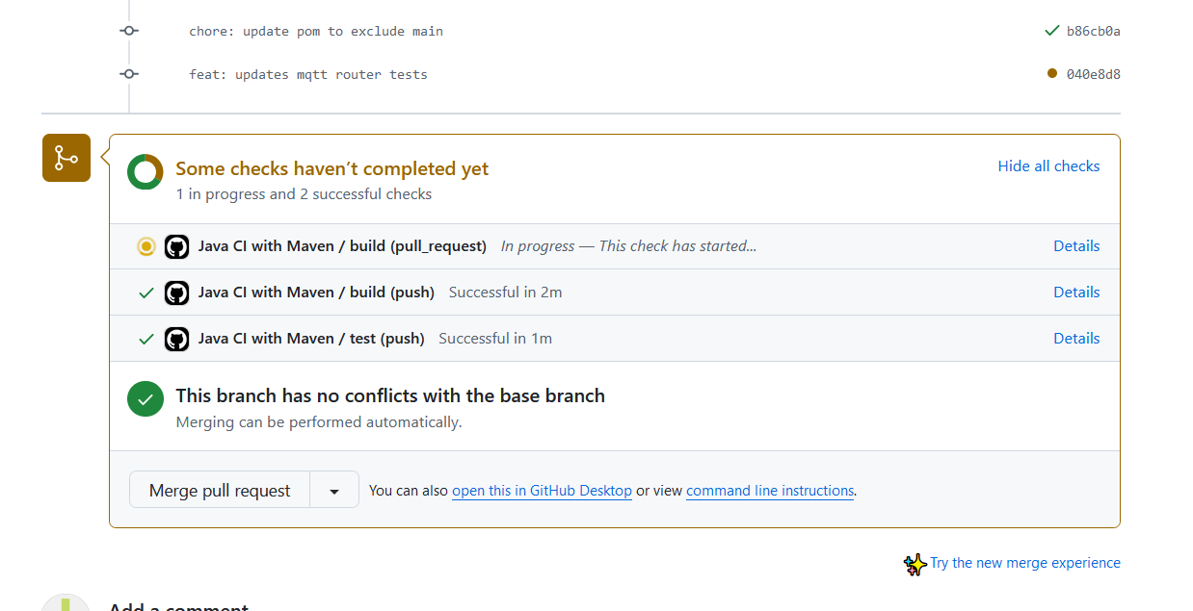
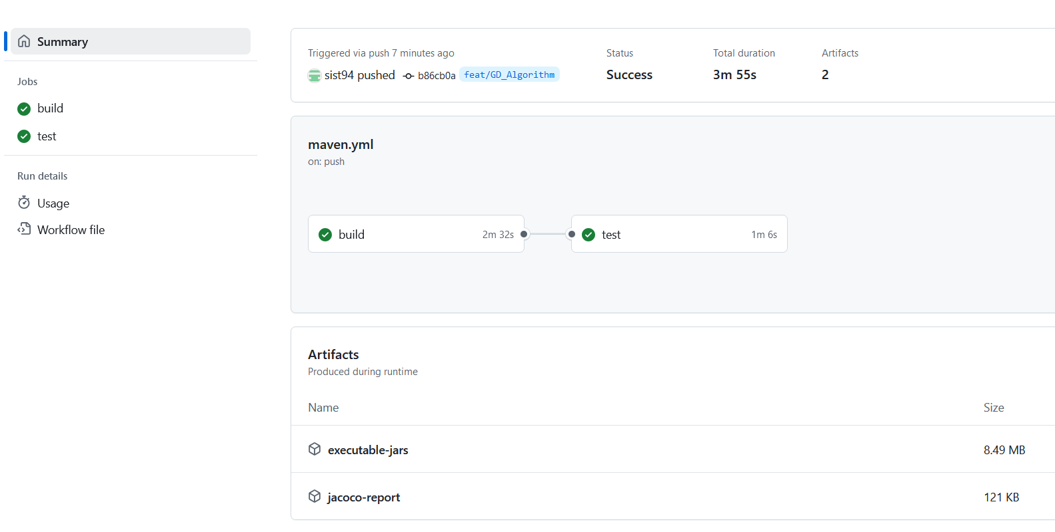
Quality Checks
CI/CD
Continuous checks via github actions
- checks at every pull request on master branch.
fetch
build
.jar files
test
test output
jacoco
coverage

Slide 9
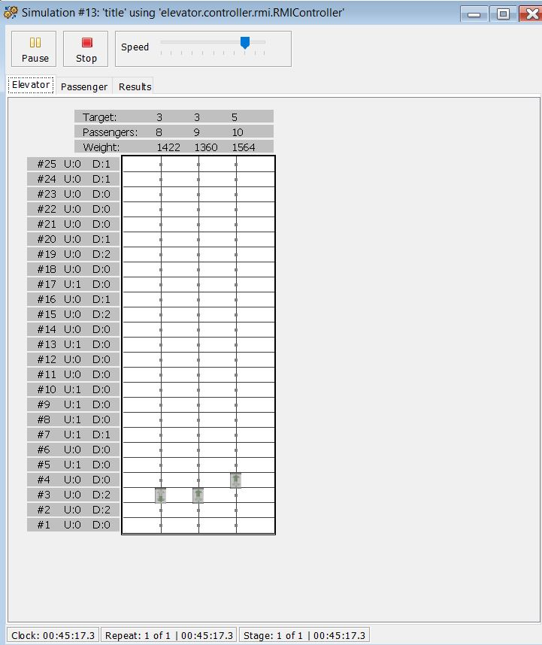
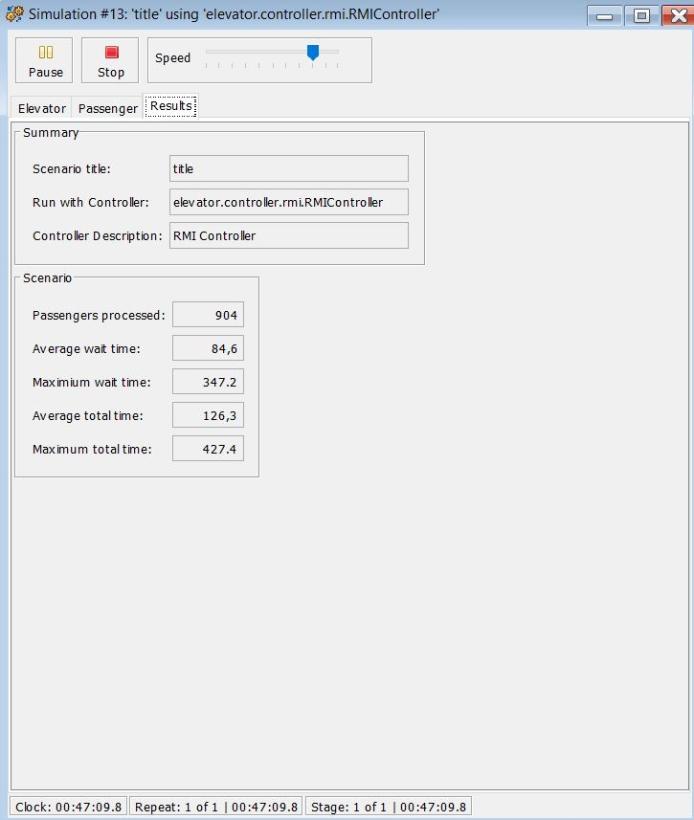
Manual Function Test
- test executed manually on own pc
- no errors after ~1h test
- max waiting time ~5min

Slide 10
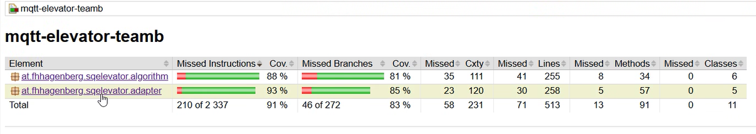
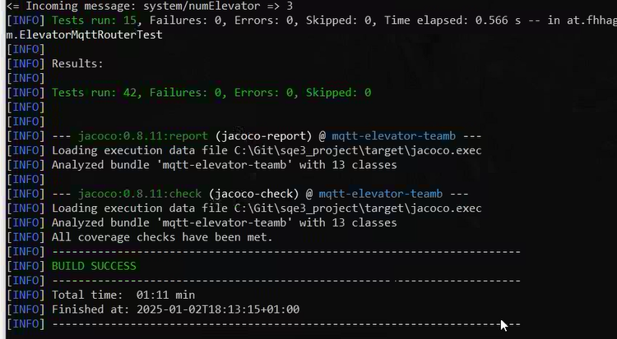
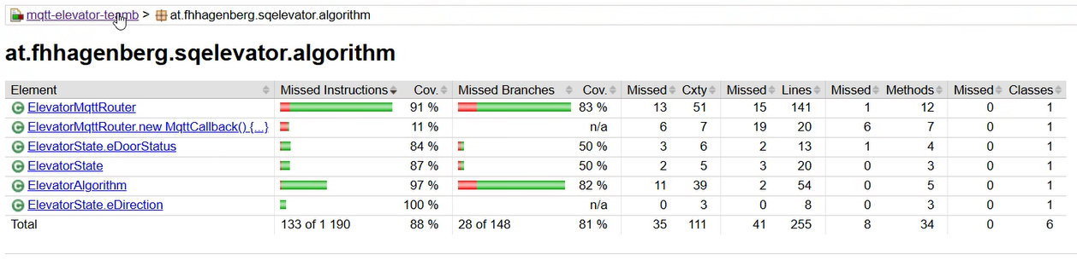
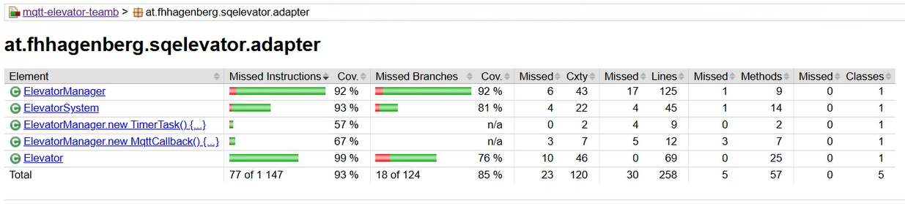
Code Coverage

Slide 11
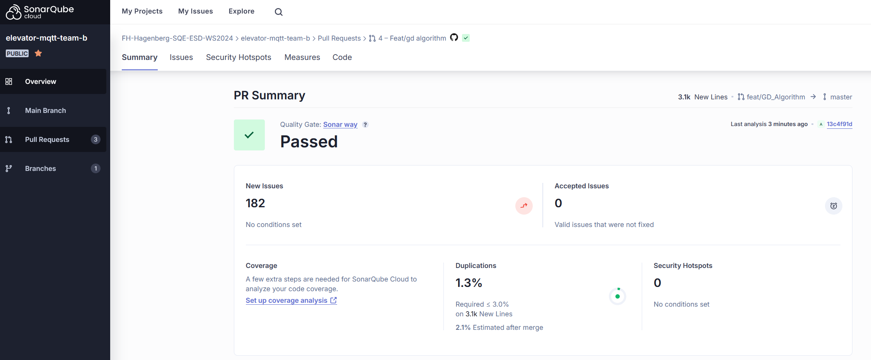
Sonar Cloud

Slide 12
Lessons Learned
- model based testing
- mocking – docker/mqtt
- CI/CD pipeline
- pair programming - Java 😥

